Slide 1
Lab 4b
Relational Event Modeling

Slide 2
Reminder about Lab 4
You have two options:
  4a (SAOM)
  4b (REM)
→ You only need to choose one for your report!
Both options have two parts:
  Part I: Hypothesis Construction
  Part II: Hypothesis Testing

Slide 3
When to use REM?
Method to analyze group interaction processes (e.g., understanding the different patterns group members engage in during interaction)
Because of the unique trace data structure of REM, the most important factor determining when to use REM is the type
of data available - you need data on fine-grained interactions (“Big Data”)
Notes:
SAOM is better for understanding network evolution (panel data instead of timestamp data)

Slide 4

MTS Skype Communication Data
Sample:
  1 multi-team system
  20 people - 4 teams of 5
  Relational events - Skype communication log
Task:
  Lead a humanitarian convoy through a hostile region
Notes:
For this assignment, we’re going to use data from the MTS experiment we talked about in lecture last week. MTS stands for multi-team system. Noshir and a team of his researchers conducted a large-scale experiment involving 20 multi-team systems, but in this lab assignment we only analyze one MTS. However one MTS includes 20 different people who are divided into 4 teams.
Relational events are based on their Skype communication. So while they were completing their task of leading a humanitarian convoy through a hostile region, they were chatting using Skype - each skype message from person A to person B is considered a relational event.

Slide 5
Part I - Hypothesis Construction

Slide 6
Constructing Hypotheses
Two key things in your hypothesis statement
  Indicate a specific relation i.e., higher or lower
  Ensure it corresponds to the given notion
Example: the notion of repetition
  RSndSnd: A sender i sending multiple messages in a sequence.
  H1a: The likelihood of individual i sending a message to individual j is greater if i has sent a message to j recently
Notes:
Similar to SAOM, make sure to include two things in your Hypothesis statements: (1) indicate a relation and (2) ensure that your statement corresponds to the appropriate notion/concept
To describe this more concretely, the first hypothesis (H1a) is given to you in the assignment and it pertains to the notion of repetition. This is captured by the model term RSndSnd - that is, a person “i” sending multiple messages in a sequence. If you see a positive estimate of this term, there is a high likelihood of i sending messages to the same person again and again. If you see a negative estimate, there is a low likelihood of i sending messages to the same person again and again.
Given this definition of the term, you might define a hypothesis like this: (given)

Slide 7
Part II - Hypothesis Testing

Slide 8
Testing Hypotheses
Yes
No
Similar to ERGM Lab
p-value < 0.05
Run a statistical test (i.e., REM)
See p-value of the proper variable
Fail to reject the null hypothesis (don’t interpret the estimate)
Accept the proposed hypothesis & interpret the estimate
Sign of the estimate aligns with the proposed hypothesis?
Reject the null hypothesis
Reject the proposed hypothesis & interpret the estimate
Notes:
I’ve shown you this flow chart many times now, so hopefully you’re familiar with it now. Hypothesis testing for REM will follow the same logic as ERGMs and SAOMs.
To test some specific hypothesis, you will include some relevant variables in your model, check the p-value to gauge significance, and if significant, you’ll check the sign on the estimate, support/reject your hypothesis and interpret the result.

Slide 9
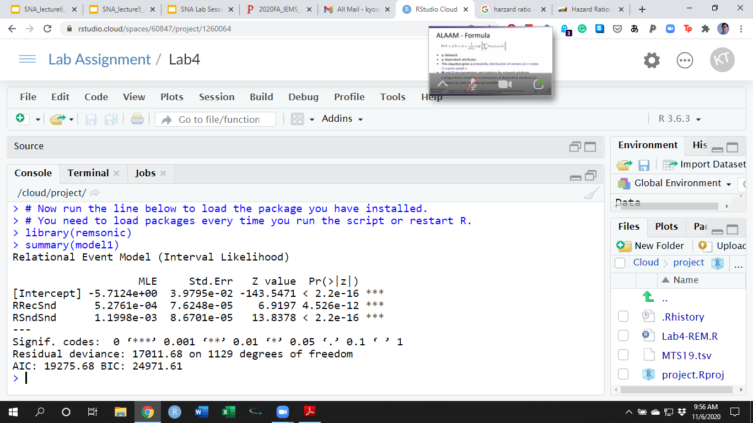
Results of Model 1
Log-hazard ratio estimates
Notes:
Now, just to make sure you all understand how to read REM output, here’s example output.
First, we see three parameters here - the intercept, RRecSnd, and RSndSnd. The intercept is a constant, so basically we have two sequential structural signatures here - RSndSnd pertains to Hypothesis 1a and RRecSnd pertains to Hypothesis 1b.
Next you see the estimates. In this case, these estimates are based on the log-Hazard ratio. I’ll explain that more in a second.
Next, you see the standard errors associated with these estimates, the Z-statistics, and the p-values. So basically the Z-statistic is testing whether these estimates are different from zero. If the p-values are less than 0.05, then these estimates are different from zero and we should interpret the estimate.

Slide 10
Results of Model 1
Interpret the sign of the coefficient as well as the significance.
Notes:
Ok so let’s interpret one of these variables here. One of the questions in the assignment is to interpret the sign of the coefficient as well as the significance.

Slide 11
H1a: Repetition/RSndSnd
The likelihood of individual i sending a message to individual j is greater if (a) i has sent a message to j recently
p-value: Is it less than 0.05?
Sign: Is it positive or negative
Testing H1a: Is it supported?
Notes:
In this case, the positive sign supports the hypothesis.

Slide 12
Hazard Ratio
The hazard ratio is a comparison between the probability of [relational] events in a (treatment) group [sending a message] and the probability of events in a (control) group [not sending it].
It’s used to see whether sending a message occurs higher (or lower) than not sending it under the condition of a particular sequential structural signature (SSS)
Notes:
Now we need to interpret the estimate. But before that, you need to know what a hazard ratio is. The hazard ratio is often used in the medical field, because they’re often interested in modeling whether an event (e.g., death) will occur given historical information.
Say you are running a randomized control experiment, where you have a set of patients who all have the same condition and you want to see whether the treatment group (who got treated with some experimental drug) is more likely to survive than the control group (who didn’t get the drug). Here, the hazard ratio is the ratio of (chance of an event occurring in the treatment arm)/(chance of an event occurring in the control arm)
In REM, we’re applying the same idea but this time taking the treatment group to be sending a message and control group to be not sending a message.
The hazard ratio is a comparison of the probability of a relational/interaction event occurring in these two groups.
On top of this, we are using a conditional hazard ratio - meaning that we’re measuring whether sending a message occurs with a higher or lower probability than not sending a message under the condition of a particular sequential structural signature.

Slide 13
Hazard Ratio
A hazard ratio of 3 means that three times the number of relational events are seen in sending a message at any point in time. Any ratio above 1 generally means that sending a message is more likely to occur than not sending it.
A hazard ratio of 1 means that both sending a message and not sending it are experiencing an equal number of events at any point in time.
A hazard ratio of 0.33 tells you that the hazard rate in sending a message is one third of that in not sending it.
Notes:
Three categories of results for the Hazards Ratio: over 1, equal to 1, or below 1.
an odds ratio of 2 means that the event is 2 times more probable given a one-unit increase in the predictor
a hazard ratio of 2 means the event will occur twice as often at each time point given a one-unit increase in the predictor.
Survival analysis,
Odds are cumulative over an entire study, using a defined endpoint

Slide 14
H1b: Repetition/RSndSnd
Run exp(1.1998e-03)
→ 1.001201 [Hazard Ratio]
How likely is it that an individual will send a message to their prior communication partner?
  The likelihood of individual i sending a message to individual j is 1.001 times higher than the likelihood of the individual i not sending a message to individual j if i has sent a message to j recently
Notes:
Because the coefficient comes back as a log-Hazards Ratio, you need to take the exponential to convert it into a Hazard Ratio.
So taking Hypothesis 1a as an example again, we see that taking the exponential gives as a Hazard Ratio of 1.001 so we can interpret the result as The likelihood of individual i sending a message to individual j is 1.001 times higher than the likelihood of the individual i not sending a message to individual j if i has sent a message to j recently
So that last if is why this is a “conditional hazard ratio” – that’s the sequential structural signature

Slide 15
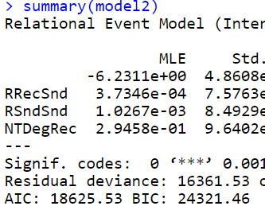
Model Comparison
Use the Bayesian Information Criterion (BIC) to compare models:
  given the same data, lower BIC is better
Notes:
You will run 5 different models in your assignment and you will compare each of them using the BIC - bayesian information criterion.
So given the same data, lower BIC is better.
AIC and BIC are both indicators of model fit - how well your model fits with the original data.
We use BIC instead of AIC because BIC penalizes overfitting. Overfitting means including too many parameters. Say you have 100 data points and 99 variables – you may have great model fit but you lose your degrees of freedom and you won’t be able to apply this model to other datasets.
Here, we see that in model 2, we added an extra variable but the BIC is still lower.
Basically these are ways of trying to determine how different your model is compared to the actual values and the lower these values are the better. But you can't really just say like, oh, if they're close to 0. That's good. They’re relative measures. So you're actually going to be creating multiple models. In this case we have model 1 and model 2. And I think in your lab you're actually going to fit 5 different models. And you're going to compare the models against each other, based on whether their values for their AIC and BIC are higher or lower. Typically AIC and BIC agree with each other, but in our case we’re going to focus on BIC because it penalizes overfitting.
AIC always has a chance of choosing too big a model, regardless of n. BIC has very little chance of choosing too big a model if n is sufficient, but it has a larger chance than AIC, for any given n, of choosing too small a model.
AIC is better in situations when a false negative finding would be considered more misleading than a false positive, and
False negative (type 2 error; omission) is that if i actually did send a message to boss but the model predicts that I didn’t send a message
a test for a disease may report a negative result, when the patient is, in fact, infected.
BIC is better in situations where a false positive is as misleading as, or more misleading than, a false negative.
False positive (type 1 error; commission) is that if i actually didnt send a message to boss but the model predicts that I send a message
The AIC or BIC for a model is usually written in the form [-2logL + kp], where L is the likelihood function, p is the number of parameters in the model, and k is 2 for AIC and log(n) for BIC.

Slide 16
Q & A

